Slide 1
Think CO Promoting Carbon Monoxide Awareness

Slide 2
How you can help by “Thinking CO”
GSC is a registered charity in England. Charity number 1131987

Slide 3
Think CO – its aim
The project aims to raise awareness of the signs and symptoms of CO (carbon monoxide) poisoning risks with people who work in the homes of vulnerable people.
Our goal is by helping you to ‘Think CO’ when you are in people’s homes, we can save lives together and keep you safe.
We need your help to do this.

Slide 4
Think CO – how it works
The project team is working with organisations like yours across the UK to raise awareness of the signs and symptoms of CO poisoning with staff and volunteers who work in the homes of vulnerable people.
By the end of this briefing, you will know the signs and symptoms of CO and also know what to do should you suspect that CO is present.

Slide 5
What does CO mean to you?
What words spring to mind when you think “carbon monoxide”?
Has anyone had any personal experiences with CO they want to share?

Slide 6
Carbon Monoxide (CO) is…
Dangerous
Low Level Exposure
Not only is CO odourless, tasteless and invisible it is extremely toxic.
Suspect many more thousands of people are affected through low level exposure.
Lethal
Approx. 40-50 people in the UK die each year
Brain Damage
Exposure can cause brain damage and affect the nervous system and memory
A&E
Is responsible for sending 4,000 people to A&E per annum and 200 are admitted.

Slide 7
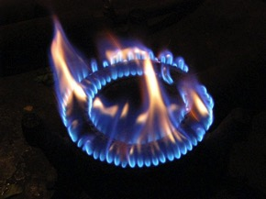
How do you spot the risks?
Yellow/orange lazy flames (instead of blue)
Sooty, yellow or brown marks around the gas fire/cooker
Excessive condensation – windows and walls
Signs of scorching around the fire
Pilot light keeps going out
ACTION: When you visit a client’s home, keep a look out for blocked ventilation sources such as chimneys, flues and air vents

Slide 8
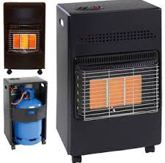
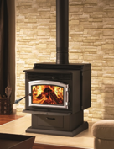
Remember – it’s not just mains gas
Any carbon based fuel that does not burn properly is a risk
Liquid Petroleum Gas (LPG)
Coal fires
Charcoal BBQs
Peat
Wood fires (incl. burners)
Petrol / oil engines and heaters
Cooking practices

Slide 9
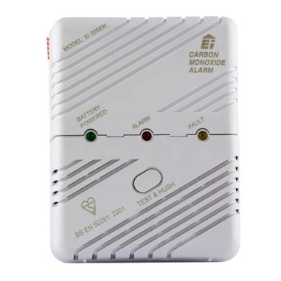
Client’s protection
CO Alarms - many different types but ensure it has BS EN 50291 code
Costs vary - £20-60
Read instructions – not too low and not too high
CO rises very slowly
Should have one in every place that has a potential source of CO
Consider clients with sensory deprivation
Annual boiler servicing and chimney cleaning

Slide 10
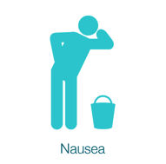
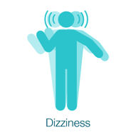
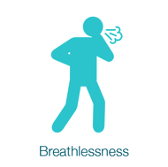
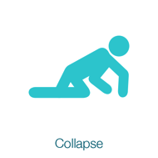
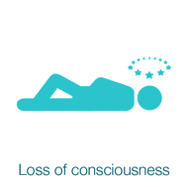
Symptoms – what to look out for

Slide 11
Symptoms – What to look out and listen for
Common first symptom is being unusually tired for you
Similar to flu and food poisoning and seems to last a long time
Dizziness can lead to falls
Symptoms disappear or reduce when client is outside the home and reappear when they return
Other family members, visitors or pets suffer similar symptoms
Metallic taste in your mouth
Worse in winter

Slide 12
Emergency Scenario - what should you do
1
2
3
4
Get yourself and your client out of the house as soon as possible
Turn off gas, all appliances and open windows
Call emergency services
If you or your client feel unwell go to GP or to A&E
Remember - Don’t put yourself at risk

Slide 13
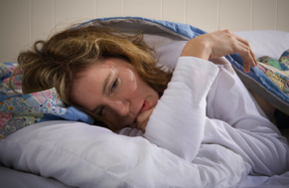
Case study
A worker for a charity told us her story that she was feeling tired, dizzy and nauseous. She went to her GP three times. On the first two occasions she was told that the most likely reason was that she was pregnant and was given pregnancy tests. Only on her third GP visit did she insist on other tests. The result was that she was suffering from CO poisoning which turned out to be from a badly fitted flue in her attic which meant she was sleeping in a bedroom with significant levels of CO present every night.

Slide 14
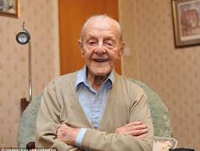
Case study
Two workers from a housing association shared the story that an older man who was a tenant of the association kept coming to them complaining of tiredness and nausea. When they checked, he had a faulty boiler, which latterly had to be condemned, and a new one fitted. His GP has dismissed his symptoms as “old age”.

Slide 15
Steps to take…
if you suspect there might be a risk of low level CO poisoning in a client’s home
6. An option might be to put CO detector in house for 24 hrs
1. You’re concerned by what you’ve seen or heard
5. If risk to client or visitor continues agree action with manager
The key point is your organisation needs to agree the procedure
2. Suggest a registered gas engineer visits but remember cost may be a worry for the client
4.See if any £ support is available (see FAQs)
3. Talk to your manager or supervisor if not resolved

Slide 16
What happens if the gas is turned off?
If a vulnerable client has their gas turned off, your organisation should aim to ensure there is a procedure to follow to provide emergency heating/cooking and help to address any problems that arise. Get to know what your organisation’s policy and practice is.
See the Think CO FAQs sheet and your organisation’s policy for ideas of who to contact to help with servicing, new boilers, heaters, cooking appliances etc…

Slide 17
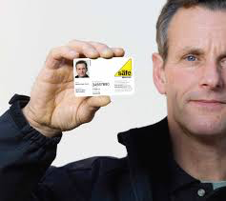
Finally – the ‘Think CO’ Top Tips
Read the ‘Think CO’ handout
Encourage your clients to get their gas appliances checked annually and to always use a Gas Safe Registered engineer (www.gassaferegister.co.uk / 0800 408 5500)
Encourage clients to sweep any chimneys regularly
Advise clients to fit an audible CO alarm and make sure it meets the BS EN 50291 standard
Look out for the poster
Listen to your clients

Slide 18
Quiz
How many people on average die p.a. from CO poisoning in UK?
What circumstances generates carbon monoxide gas?
What colour gas flame do you need to be wary of?
What are the main sources of CO in the home?
What are similarities between a bad hangover and CO poisoning?
What kind of engineer should service your boiler?
What are the dates of Gas Safe Week in 2017?
What should you look for in a CO detector?
Why might CO prevention reduce hospital admissions?
Why might SMART meters help reduce CO problems?

